Slide 1
Blinkit Analysis
Business Requirement:
Conduct a comprehensive analysis of Blinkit's sales performance, customer satisfaction, and inventory distribution to find insights and opportunities for optimization using various KPIs and Power BI visualizations.
KPI’s Requirement:
Total Sales: The overall revenue generated from all items sold.
Average Sales: The average revenue per sale.
Number of Items: The total count of different items sold.
Average Rating: The average customer rating for items sold.

Slide 2
Business Requirement:
Chart’s Requirement:
Total Sales by Fat Content:
    Objective: Analyse the impact of fat content on total sales.
    Additional KPI Metrics: Assess how other KPIs (Average Sales, Number of Items, Average Rating) vary with fat content.
    Chart Type: Donut Chart.
Total Sales by Item Type:
    Objective: Identify the performance of different item types in terms of total sales.
    Additional KPI Metrics: Assess how other KPIs (Average Sales, Number of Items, Average Rating) vary with fat content.
    Chart Type: Bar Chart.
Fat Content by Outlet for Total Sales:
    Objective: Compare total sales across different outlets segmented by fat content.
    Additional KPI Metrics: Assess how other KPIs (Average Sales, Number of Items, Average Rating) vary with fat content.
    Chart Type: Stacked Column Chart.

Slide 3
Business Requirement:
Chart’s Requirement:
Total Sales by Outlet Establishment:
    Objective: Evaluate how the age or type of outlet establishment influences total sales.
    Chart Type: Line Chart.
Sales by Outlet Size:
    Objective: Analyse the correlation between outlet size and total sales.
    Chart Type: Donut/ Pie Chart.
Sales by Outlet Location:
    Objective: Assess the geographic distribution of sales across different locations.
    Chart Type: Funnel Map.
All Metrics by Outlet Type:
    Objective: Provide a comprehensive view of all key metrics (Total Sales, Average Sales, Number of Items, Average Rating) broken down by different outlet types.
    Chart Type: Matrix Card.

Slide 4
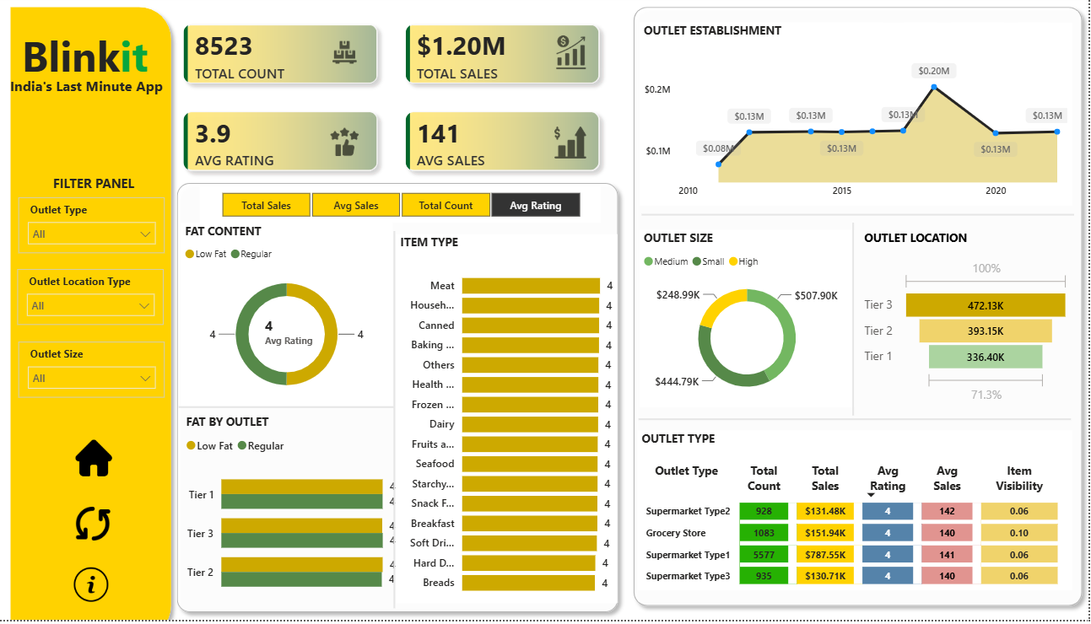
Dashboard:

